Slide 1
Natural Language Processing
Dr Mehreen Alam
Lecture 1

Slide 2
Contents
Instructor
Outline
Text & reference Material
Grading
Objectives
Motivation
Challenges
Intro to Word2Vec

Slide 3
Instructor
Dr Mehreen Alam
Assistant Professor
Telephone - 639
Email
mehreen.alam@nu.edu.pk
Office hours
1130 hrs to 1400hrs – Monday

Slide 4
Outline
It is mainly covers:
Word Embeddings
Neural Networks based methods
Statistical Methods
Application of NLP
Project/Paper
NeurIPS, ICLR, ICML, EMNLP, NAACL

Slide 5
Text & reference Material
http://web.stanford.edu/class/cs224n/
Links shared in the slides
Dan Jurafsky and James H. Martin. Speech and Language Processing (3rd ed. draft)
Jacob Eisenstein. Natural Language Processing
Yoav Goldberg. A Primer on Neural Network Models for Natural Language Processing

Slide 6
Grading (tentative)
Mid-Term Exams 25%
Assignments 10%
Project/Paper 10%
Quizzes 10%
Final Exams 45%
Marks division most likely to change during the semester
Absolute Grading

Slide 7
Objectives
This course introduces the fundamental concepts and techniques of natural language processing (NLP). Students will gain an in-depth understanding of the computational properties of natural languages and the commonly used algorithms for processing linguistic information. The course examines NLP models and algorithms using both the conventional as well as state-of-the-art deep learning approaches.
Multi-disciplinary field, plan to cover
computational treatments of words, sounds, sentences, meanings, and conversations.
how probabilities and real-world text data can help.
how different levels interact in state-of-the-art approaches to applications like translation and information extraction.

Slide 8
NLP:
Natural Language Processing is the study of computational methods for working with voice and text data.
Goal: for computers to process or “understand” natural language in order to perform tasks that are useful

Slide 9
Applications
translation,
summarization,
extracting information,
question answering,
natural interfaces to databases,
conversational agents,
and many many more….

Slide 10

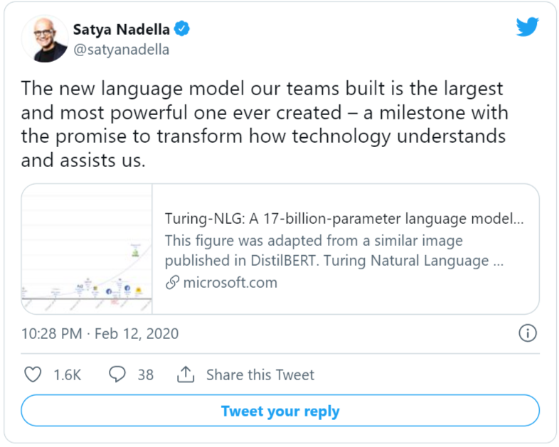
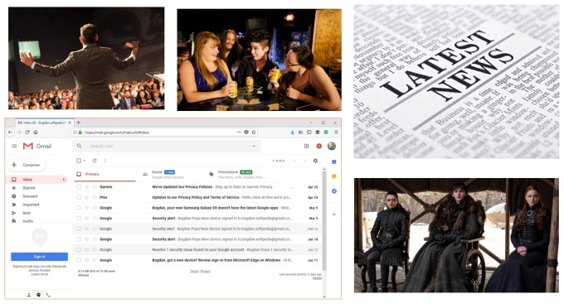
Motivation

Slide 11
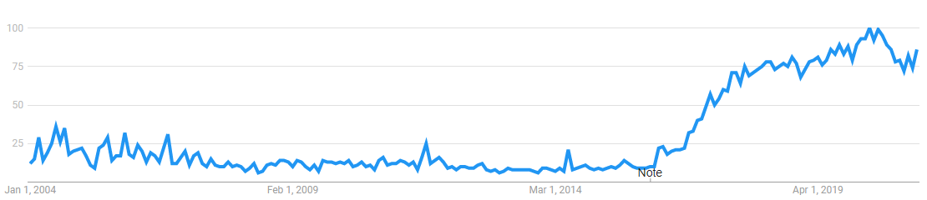

World trend towards chatbots

Slide 12
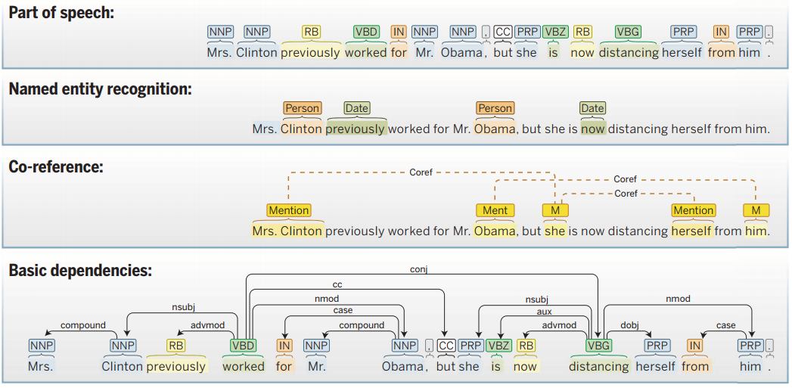

If text is so important, the follow-up question is:
why has technology failed to keep up with the scope at which natural language is used?
https://techcrunch.com/sponsor/nvidia/how-the-revolution-of-natural-language-processing-is-changing-the-way-companies-understand-text/

Slide 13
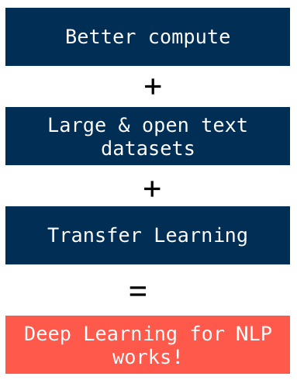
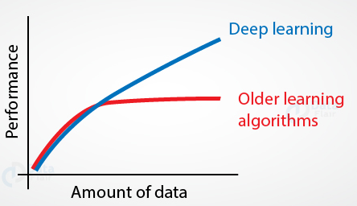
NLP has made more progress in the past three years than any other field in machine learning.

Slide 14
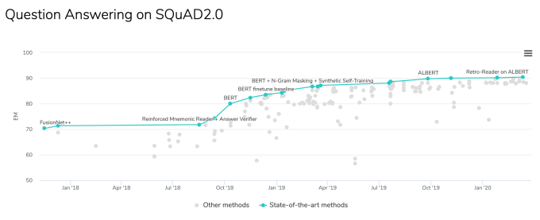
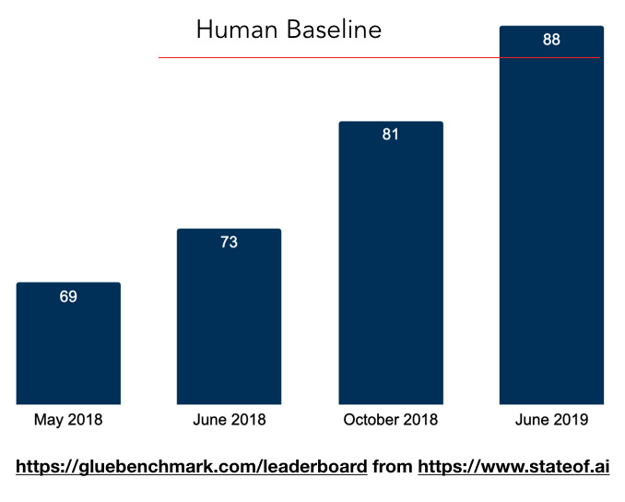

Slide 15
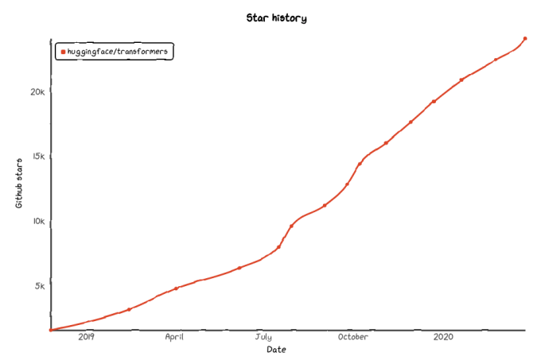

companies to adopt these new models
faster than anything we have seen before.

Slide 16
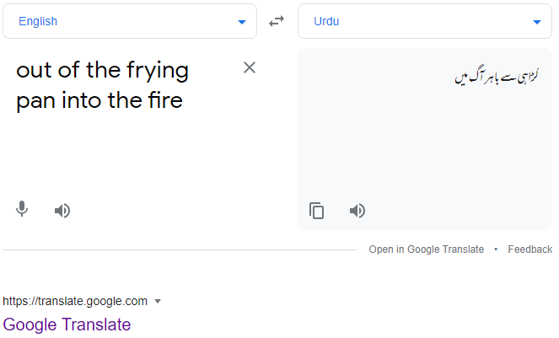
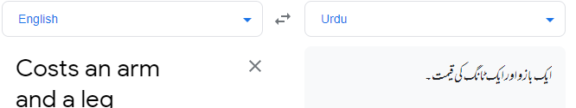
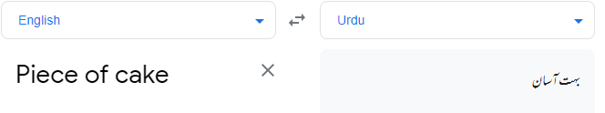
Challenges
Tone
Sarcasm, figurative languages, idioms,
Context, commonsense, etc.

Slide 17

Challenges
Evolving use of language:
Google, photoshop, internet,..
Language morphology:
Stem, stemming, stemmer, ..

Slide 18
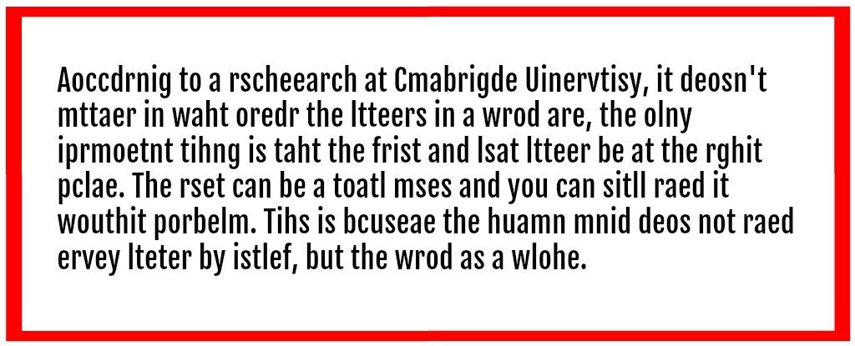
Challenges
Precision
Human speech not precise, unambiguous, complex variables, regional dialects, social context, etc.

